Slide 1

Python & Data Science Training Project 5 – Mortgage Default Model & Mortgage Prepayment Model

Slide 2
Contents
Link to the data
What we are going to learn in 4 weeks
week 1: machine learning
week 2: logistic regression, K-means clustering
week 3: ANN and CNN of deep learning
week 4: Survival analysis
The problem of overfitting
Experimental design for building a predictive model
IV. Key knowledge not covered but you need to gain

Slide 3
I. Link to the file for the project
- We will be using mortgage data to build multiple predictive models throughout this project.
Link to the data:
https://1drv.ms/u/s!Amfo1lixPzv-j3k_230kv-58OmZW?e=x5WIz8

Slide 4
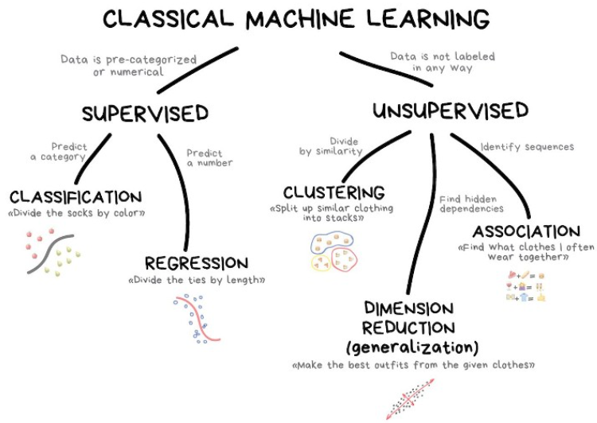
II. What we are going to learn from this project
Deep learning:
- Artificial Neural Network (ANN)
- Convoluted Neural Network (CNN)
Survival Analysis
It will generate a probability estimate for each month.
Logistic regression
Decision tree
Naïve Bayes
Gradient descent
KNN
Light Gradient Boosting
XGBoost
Random Forest
Ensemble method

Slide 5
Week 1: Machine Learning
Use multiple machine learning methods to build
Mortgage payment default model (which customers are more likely to fail to pay)
Prepayment model (which customers are more likely to prepay their mortgage
Prepayment:
- Involuntary prepayment
- A homeowner fails to make payment for consecutive 6 months.
- Voluntary prepayment
- A homeowner sells his/her house.
- A homeowner refinances his/her house
Skills gained in this exercise can be applied to such tasks as marketing campaign response modeling and fraud detection.

Slide 6
Suggestions for improving machine learning models
Use a different set of predictors for prepayment than that for payment default because the two outcomes could be driven by different factors.
For each ML algorithms, choose a different set of predictors. However, this will increase the complexity of the codes as you need to customize the evaluation function for each algorithm.

Slide 7
Week 2: Logistic regression K-means clustering
Logistic regression for an underwriting model
This is the most important skill for risk management/control in almost all companies that issue credit card
or various kinds of loans such as student loans, car loans, personal loans payday loans and mortgages.
Underwriting: decline of approval of a loan/credit application
Many machine learning algorithms perform better than logistic regression. Why still logistic regression?
- Most machine learning methods generate black-box algorithms that are explainable, but logistic
regression can explain which factors causes the outcome and to what degree. In order to meet audit or
compliance requirements, many models need to offer the contributing factors to an outcome of interest.
- Underwriting in the US are subject to laws of fair lending to prevent discrimination. A company needs to
provide reasons when declining a loan/credit applications.
K-means clustering to segment customers.
Skills gained in this exercise can be applied to such modeling tasks as marketing campaign response models and fraud detection.

Slide 8
Week 2: Compliance/Audit requirements need to be followed in building predictive models
Marketing response model – anything goes
Underwriting model – very restrictive
Only logistic regression, decision tree and business rules are allowed. All variable
selections are to be reviewed by compliance/audit department.
Logistic regression: only monotonically-behaved variables will be selected.
Decision tree: needs to reflect anti-discriminatory policies
Business rules: a series of if-then statements (sometimes derived from decision tree)
Example: if FICO > 740 and DTI < 43 and OLTV < 80 then approve
if FICO > 640 and DTI < 38 and OLTV < 75 then approve……
Fraud detection model – anything goes
Pricing model (setting interest rate) – anything goes (like what we do in Project 5.1)
In underwriting credit card applications, income cannot be used as a factor. But it can be used for deciding credit limit/line.

Slide 9
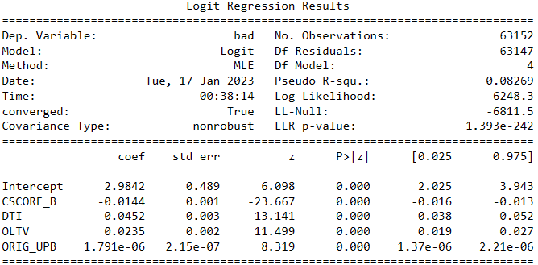
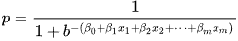
Week 2: Use logistic regression to - find which variables have higher predictive power - generate contributing factors
Option 1
Step1: Run the regression by using original variables
Step 2: Use z score (or chi square if you have it) as the contributing power for each variable.
Step3: Calculate contribution power by each variable:
contribution= coef_est*x as in
Step 4: Rank order the contribution by each model variable from highest to lowest for each observation.

Slide 10
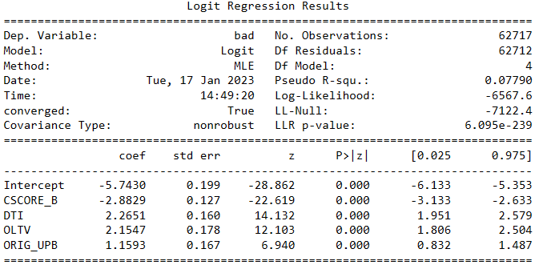
Week 2: Use logistic regression to generate contributing factors
y
More predictive
Option 2
Step 1: Normalize all input variables into a scale of [0, 1] by applying the following:
x_normalized=(x_value – x_min)/(x_max – x_min)
x
0 1
Step 2: Parameter estimate suggests contributing power by each variable.
Step 3: calculate contribution power by each variable:
contribution= coef_est*x as in
Step 4: Rank order the contribution by each model variable from highest to lowest for each observation.
The slope indicates predictive power

Slide 11
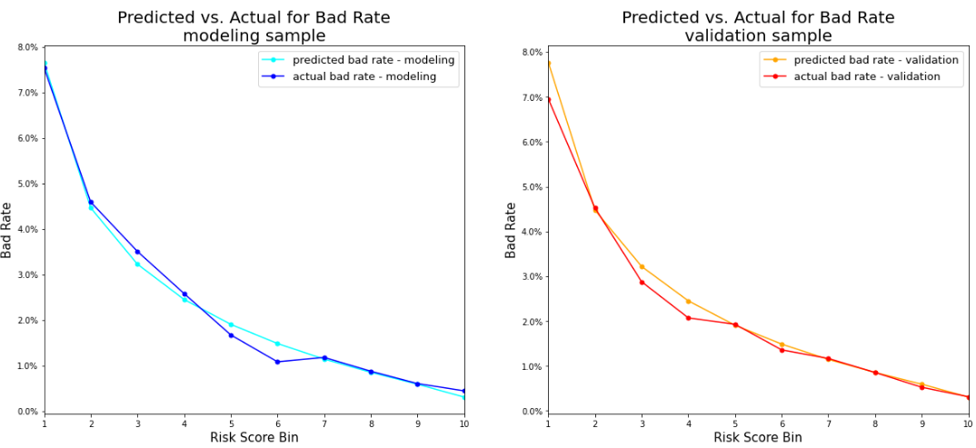
Week 2: Metrics for evaluating a predictive model Step 1: rank score from highest to lowest Step 2: cut the probability estimate into some (usually 10) evenly divided bins Step 3: Does prediction look close to actual? Step 4: Does validation sample look close to modeling sample in performance? Step 5: How much lift can the model provide?
Step 1 – Step 3

Slide 12
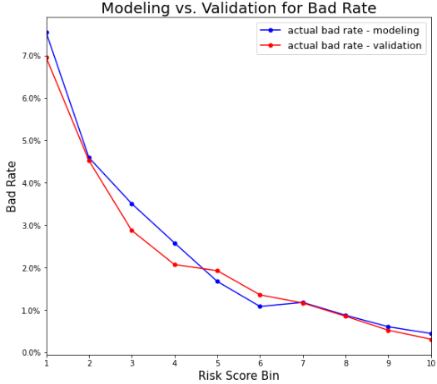
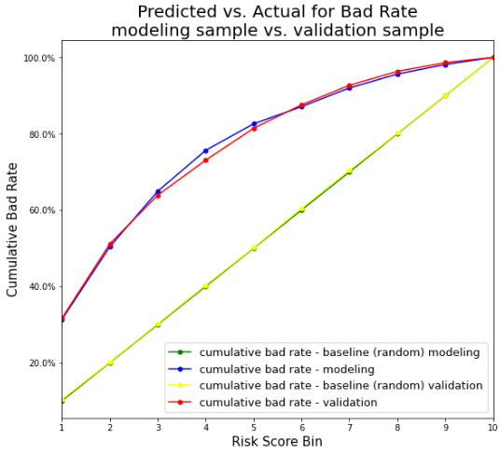
Week 2: How to read lift/gains chart Step 1: cut the probability estimate into 10 evenly divided bins (deciles) Step 2: rank score bins from highest to lowest Step 3: Does probability estimate look close to actual? * Step 4: Does validation sample look close to modeling sample in performance? Step 5: How much lift can the model provide?
Step 4:
The validation sample looks quite close to modeling sample in performance.
Risk of highest decile is 20+ times as high as that of lowest decile.
The bigger risk separation, the better.
KS statistics:
Modeling sample: 0.365
Validation sample: 0.345
Step 5
0.695
If we decline 20% of applicants, we can reduce risk by 51%.
he fatter the curve, the better the model.
If we decline 10% of applicants, we can reduce risk by 32%.
0.00311
*: Some predictive models only use the score for rank ordering (from highest to lowest). In such cases we do not require the score (or probability estimate) to be close to actual.

Slide 13
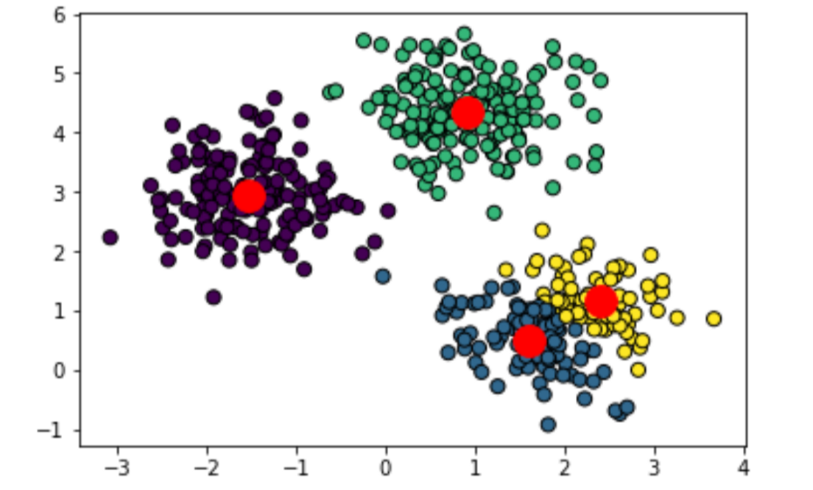
Week 2: K-means clustering Most popular and most widely used method of unsupervised learing
Group observations into different clusters according to their similarity in variables.
In this step, only input variables Xs are used. Target
variable Y is not used.
After the clusters have been generated, we can apply Y to each cluster to find out whether any cluster(s) will show much higher (or much lower) performance.
Examples:
In fraud detection, we want to find out customers in of one or more clusters show much high fraud rate.
In marketing analysis, we want to find out whether some cluster(s) will show much higher response rate.

Slide 14
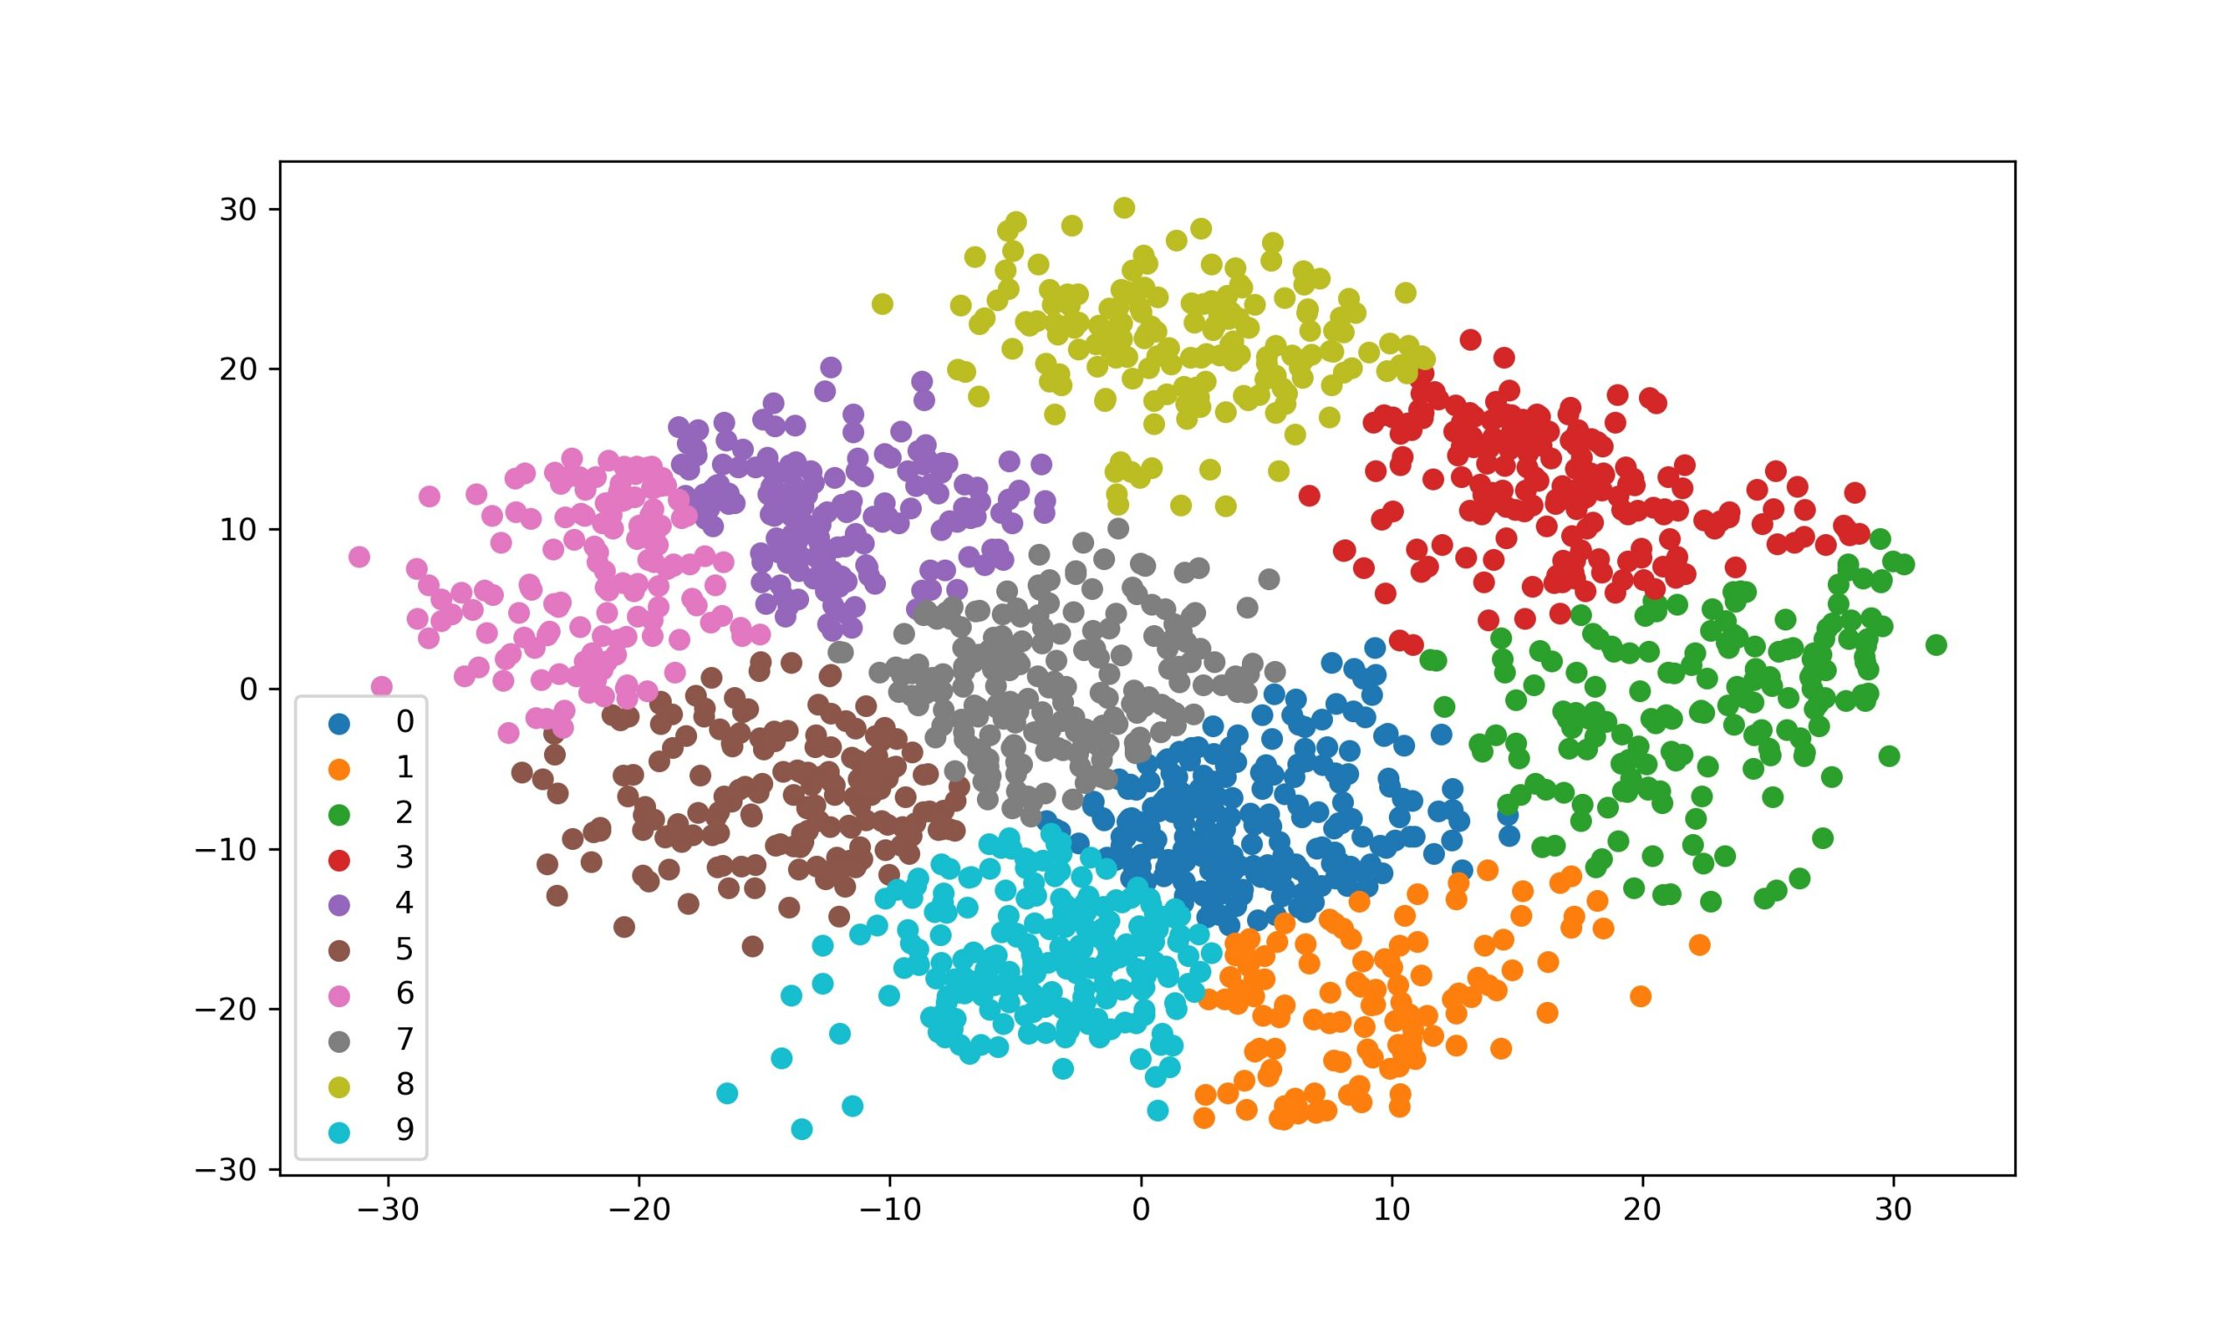
Week 2: K-means clustering You can make different combinations of clusters for different business uses.
Suppose a company has 5mm customers that have been divided into 10 clusters.
This cluster has best potential for cross-sell
These three clusters have highest risk.
These three cluster have the worst retention rate

Slide 15
Week 3: Deep learning
Use Artificial Neural Network (ANN) & Convolutional Neural Network (CNN) to build
Mortgage default model (which customers are more likely to fail to pay)
Prepayment model (which customers are more likely to prepay their mortgage
Prepayment:
- Involuntary prepayment
- A homeowner fails to make payment for consecutive 6 months.
- Voluntary prepayment
- A homeowner sells his/her house.
- A homeowner refinances his/her house
- In the demo we will be building a risk model only. The framework can be applied to a prepayment model as well
- Skills gained in this exercise can be applied to such tasks as marketing campaign response modeling and fraud detection.

Slide 16
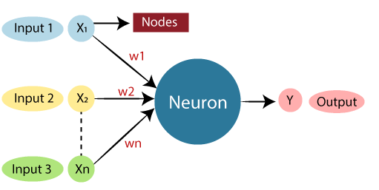
Week 3: Deep learning - Neural network emulate the behavior of a human brain
https://www.datasciencecentral.com/logistic-regression-as-a-neural-network/
https://sebastianraschka.com/faq/docs/logisticregr-neuralnet.html

Slide 17
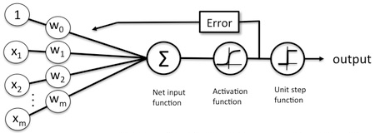
Week 3: Deep learning - Often associated with neural networks - Logistic regression can be considered as a one-layer neural network.
Sigmoid function
β is the same as w
https://www.datasciencecentral.com/logistic-regression-as-a-neural-network/
https://sebastianraschka.com/faq/docs/logisticregr-neuralnet.html

Slide 18
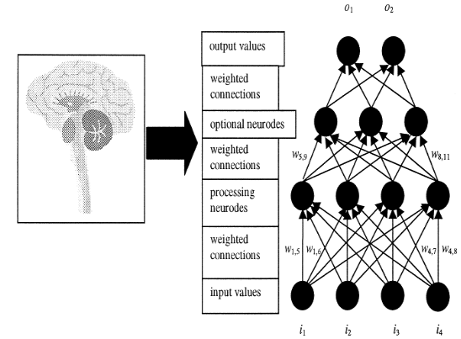
Week 3: Deep learning - Artificial Neural Network (ANN) usually contains more than one neuros and 1-N layers.
https://www.datasciencecentral.com/logistic-regression-as-a-neural-network/
https://sebastianraschka.com/faq/docs/logisticregr-neuralnet.html

Slide 19

Week 3: Deep learning - Convolutional Neural Network (CNN) is more often used in computer vision. - The last several steps applies to classification model unrelated to images.
We will only use these steps.
https://towardsdatascience.com/a-comprehensive-guide-to-convolutional-neural-networks-the-eli5-way-3bd2b1164a53
https://cs231n.github.io/convolutional-networks/

Slide 20
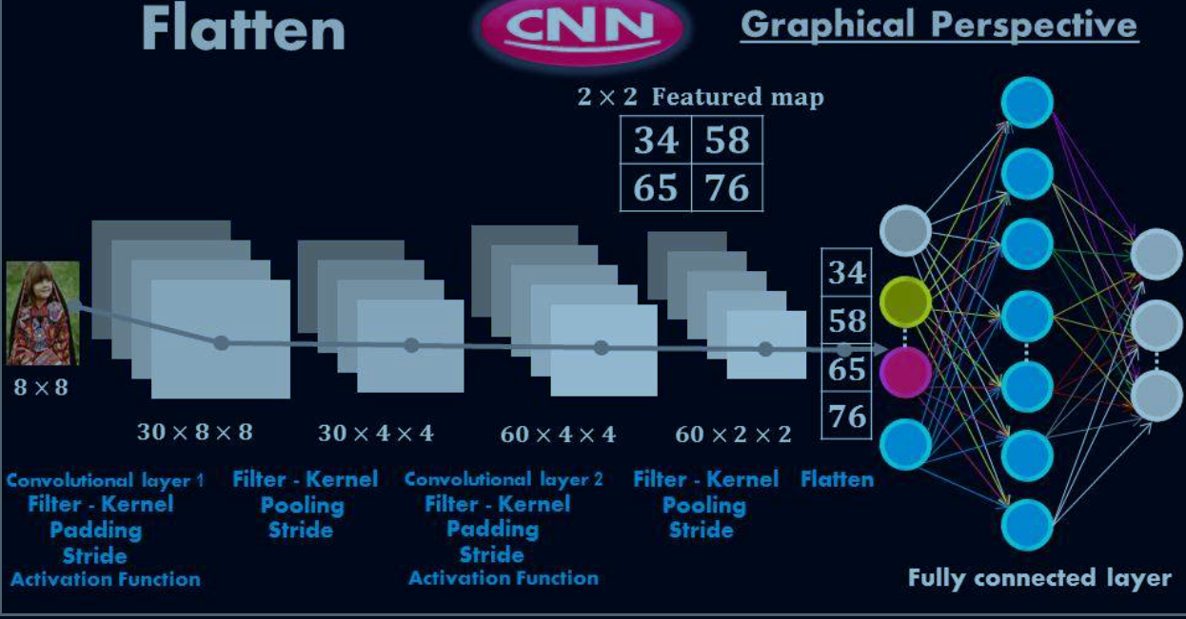
Week 3: Deep learning - Convolutional Neural Network (CNN) is more often used in computer vision. - The last several steps applies to classification model unrelated to images.
We will only use these steps.
https://towardsdatascience.com/a-comprehensive-guide-to-convolutional-neural-networks-the-eli5-way-3bd2b1164a53
https://cs231n.github.io/convolutional-networks/

Slide 21
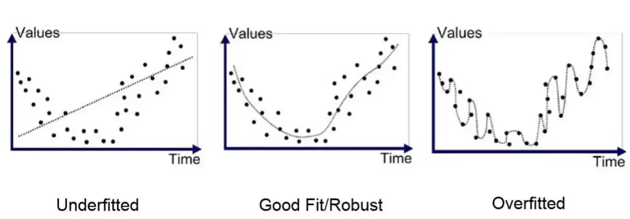
Week 3: Deep learning - To avoid overfitting, usually 20%-50% of input data and layers are dropped.
- This is similar to not using all variables in building a predictive model.
- If all variables are used in building a predictive model, the model will be very likely to overfit.
See Part III for a discussion on overfit.

Slide 22

Week 4: Survival Analysis - Kaplan Meier Curve - Cox Proportional Hazards Model
Use Survival Analysis to approach
Mortgage default (which customers are more likely to fail to pay)
Prepayment (which customers are more likely to prepay their mortgage
Prepayment:
- Involuntary prepayment
- A homeowner fails to make payment for consecutive 6 months.
- Voluntary prepayment
- A homeowner sells his/her house.
- A homeowner refinances his/her house
Survival analysis not only gives the probability estimate of the event of interest along different periods in time, e.g., by month.
It can be applied to any time-of-life analysis such as attrition analysis, time-to-failure modeling, etc.

Slide 23
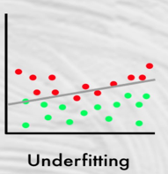
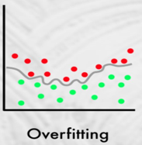
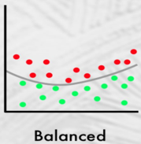
III. The problem of overfitting Let’s start with a not-so-good analogy : What are the typical physical traits of East Asians and Southeast Asians?
This question appears in every DS interview.
black hair, black eyes
Problem: correct description, but too general and hence useless. It describes many people of different races, including many non-Asians.
In the US, if you apply this description, most people selected will be non-East-Asian, given that the latter is a small portion in population.
Black hair, black eyes, light brown and smooth skin, less body hair, thin lips, height between 5.5 feet and 5.9 feet, speak softly,......
Problem: too specific and too detailed. The description loses generality that it only describes a small portion of Asian.
Black hair, black eyes, light brown and smooth skin, less body hair
A model cannot escape errors.
Some non-Asians will be included (false positive)
Some Asians will be excluded (false negative)
We want to reduce or minimize the errors. The description tries to cover as many East Asian as possible while excluding as many non-Asians as possible at the same time.

Slide 24
Diagnosis of overfitting
Cause:
Modelers often have the tendency of maximizing the use of data in order to build the best model. This could easily cause overfitting.
Overfitting: The model describes the sample too well that it loses generality in prediction.
Symptom of overfitting:
The accuracy rate drops considerably
Modeling sample: 96%
Validation sample: 75%
Remedy for overfitting:
Consistent performance from modeling sample to validation sample is an effectively way to reduce overfitting.
When a model over-explains the noise, it causes overfitting.
Build a theory/model based on the modeling sample
Test the theory/model on the validation sample
Consistent performance proves that the theory/model works.
Overfitting is often associated with:
Too many variables in the model.
Variables too similar in nature (multicollinearity).
Sample too small.
Algorithm too complex and convoluted.

Slide 25
III. Experimental design for building a predictive model
If the sample comprises of data from different periods.
If there are no differences in impactful events or major policy changes between two periods.
Most common approach
Example: train_test_split in scikit learn
modeling sample
(60% - 80%)
generate an algorithm
modeling sample
(early period)
generate an algorithm
a sample
Randomly split to
a sample
split to
two periods
Apply algorithm on
Apply algorithm on
validation sample
(20% - 40%)
validation sample
(late period)

Slide 26
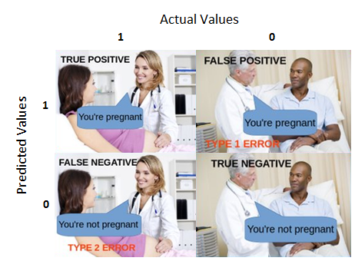
IV. Key knowledge not covered but you need to gain for building a classification model
Common metrics used for evaluating a classification model:
- Precision
- Accuracy
- Recall
- F1 Score
Check tutorials online to learn more about the above.

Slide 27
